Slide 1
Classical Planning
Md Mehrab Hossain Opi
CSE 4109: Artificial Intelligence

Slide 2
Motivation
Earlier problem-solving agents use atomic states.
Need good domain specific heuristics.
Logical agents can use domain-independent heuristics but get overloaded with too many ground actions/states.
Factored representation is used to solve this complexity.
Using PDDL.
Each State is represented as a set of variables (fluents) that are ground functionless atoms.

Slide 3
PDDL
Planning Domain Definition Language is the standard language to describe planning problem.
Each problem is defined by
Initial State
Available Actions
Result Functions
Goal Test

Slide 4
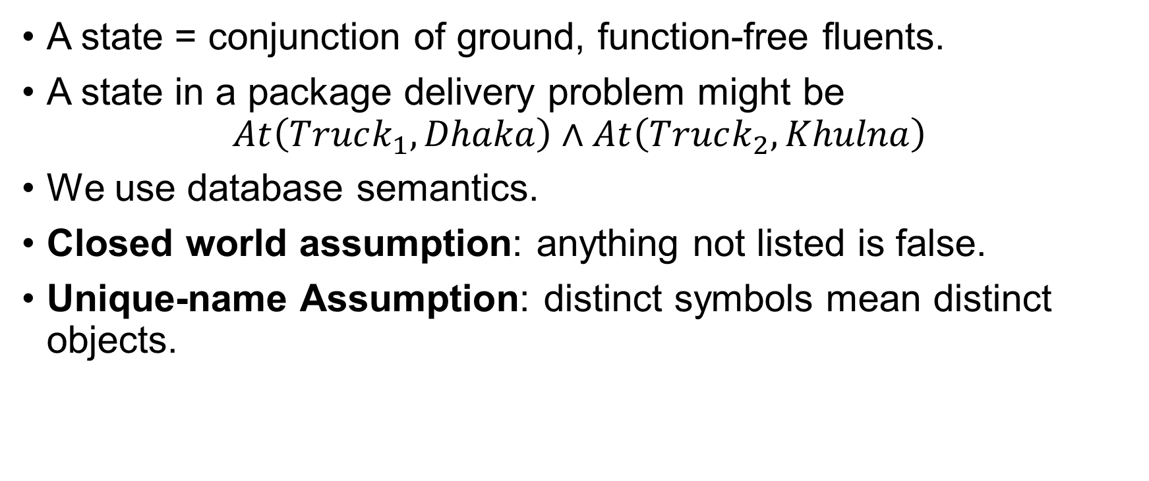
Representation of States
A state = conjunction of ground, function-free fluents.
A state in a package delivery problem might be $At\left(Truck_{1}, Dhaka\right)∧At\left(Truck_{2}, Khulna\right)$
We use database semantics.
Closed world assumption: anything not listed is false.
Unique-name Assumption: distinct symbols mean distinct objects.

Slide 5
Actions and Action Schemas
Actions are described by a set of action schemas.
that implicitly define the ACTIONS(s)and RESULT(s, a) functions needed to do a problem-solving search.
A set of ground (variable-free) actions can be represented by a single action schema.
Classical planning concentrates on problems where most actions leave most things unchanged.

Slide 6
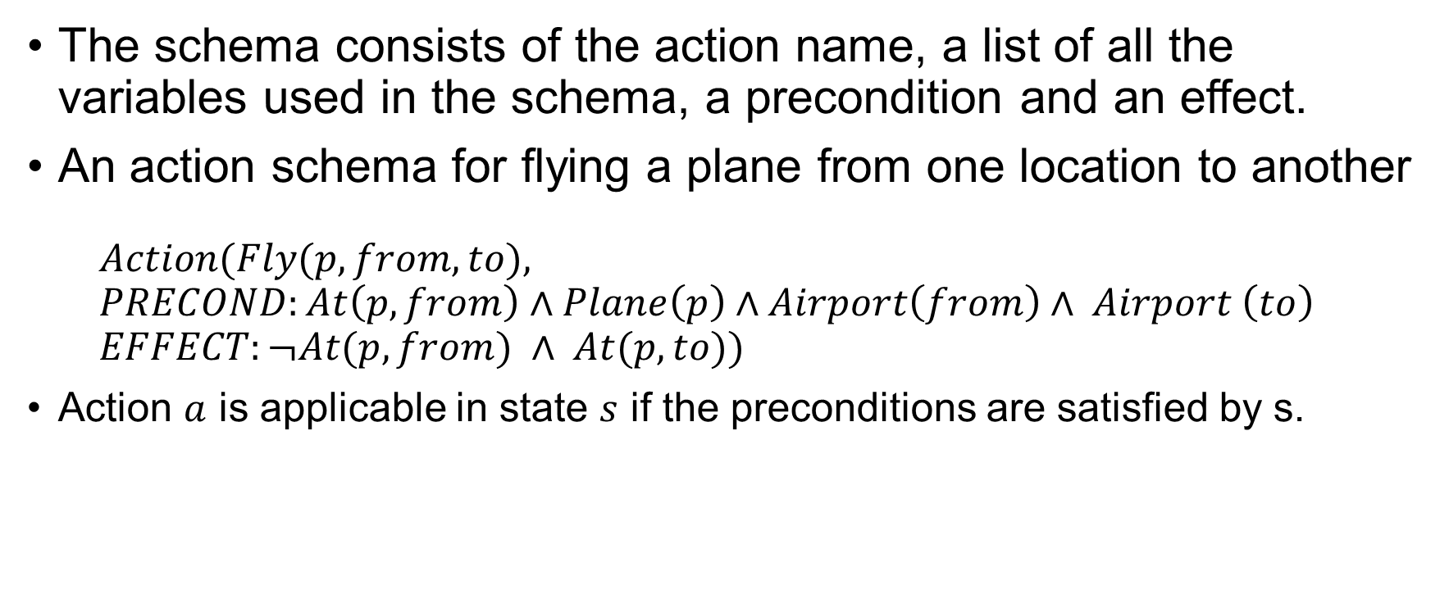
Action Schema
The schema consists of the action name, a list of all the variables used in the schema, a precondition and an effect.
An action schema for flying a plane from one location to another $Action(Fly(p, from, to),$ $PRECOND:At\left(p, from\right)∧Plane\left(p\right)∧Airport\left(from\right)∧ Airport \left(to\right)$ $EFFECT:¬At(p, from) ∧ At(p, to))$
Action $a$ is applicable in state $s$ if the preconditions are satisfied by s.

Slide 7

Applying Action
Executing an action changes a state using:
$RESULT(s, a) = (s – DEL(a)) ∪ ADD(a)$
ADD list: fluents added to the state.
DELETE list: fluents removed from the state.
Ensures all resulting states are ground (variable-free).

Slide 8
Planning Domain and Problem Definition
A planning domain = set of action schemas.
A specific planning problem = domain + initial state + goal.
Air Cargo Transport Problem
Initial state: positions of planes and cargoes.
Actions: Load, Unload, Fly.
Goal: cargoes reach destination airports.

Slide 9
Goal Satisfaction
Goal = conjunction of positive or negative literals.
A state satisfies a goal if it entails all goal fluents.
Example:
Rich ∧ Famous ∧ Miserable ⊨ Rich ∧ Famous.
Goals can include existential variables (e.g., “there exists a plane at SFO”)

Slide 10
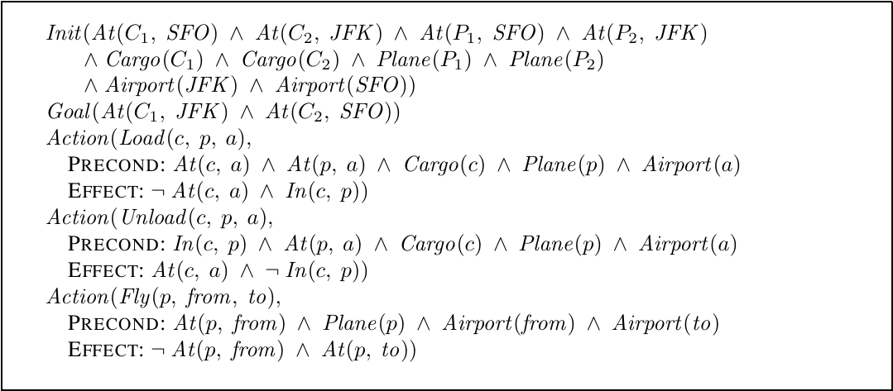
PDDL of Air Cargo Transportation Problem

Slide 11
The Blocks World
The domain consists of a set of cube-shaped blocks sitting on a table.
The blocks can be stacked, but only one block can fit directly on top of another.
A robot arm can pick up a block and move it to another position, either on the table or on top of another block.

Slide 12
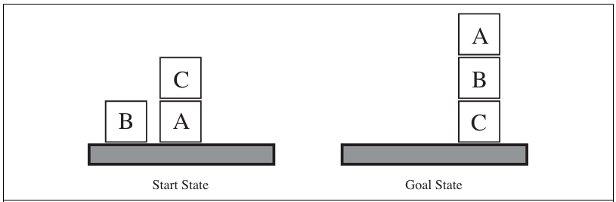
The goal will always be to build one or more stacks of blocks, specified in terms of what blocks are on top of what other blocks.

Slide 13
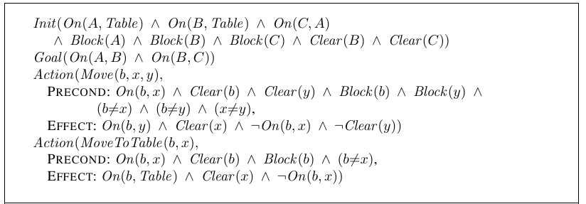
PDDL for Blocks World

Slide 14
Planning as Search
A planning problem is defined by:
Initial state
ACTIONS(s)
RESULT(s, a)
Goal test
Objective: find a sequence of actions leading from start to a goal state.
Classical planning = search over state space using action schemas and logical structure.

Slide 15
Overview of Planning Algorithms
A planning problem defines a search problem.
We can search forward from the initial state or backward from the goal.
Declarative action schemas allow both direction of search.

Slide 16
Forward (Progression) Search
Start from initial state, apply actions forward until reaching the goal.
Equivalent to regular heuristic search (like A*).
Early researchers thought it was too inefficient.
Explores many irrelevant actions.
Huge branching factor and state space.

Slide 17
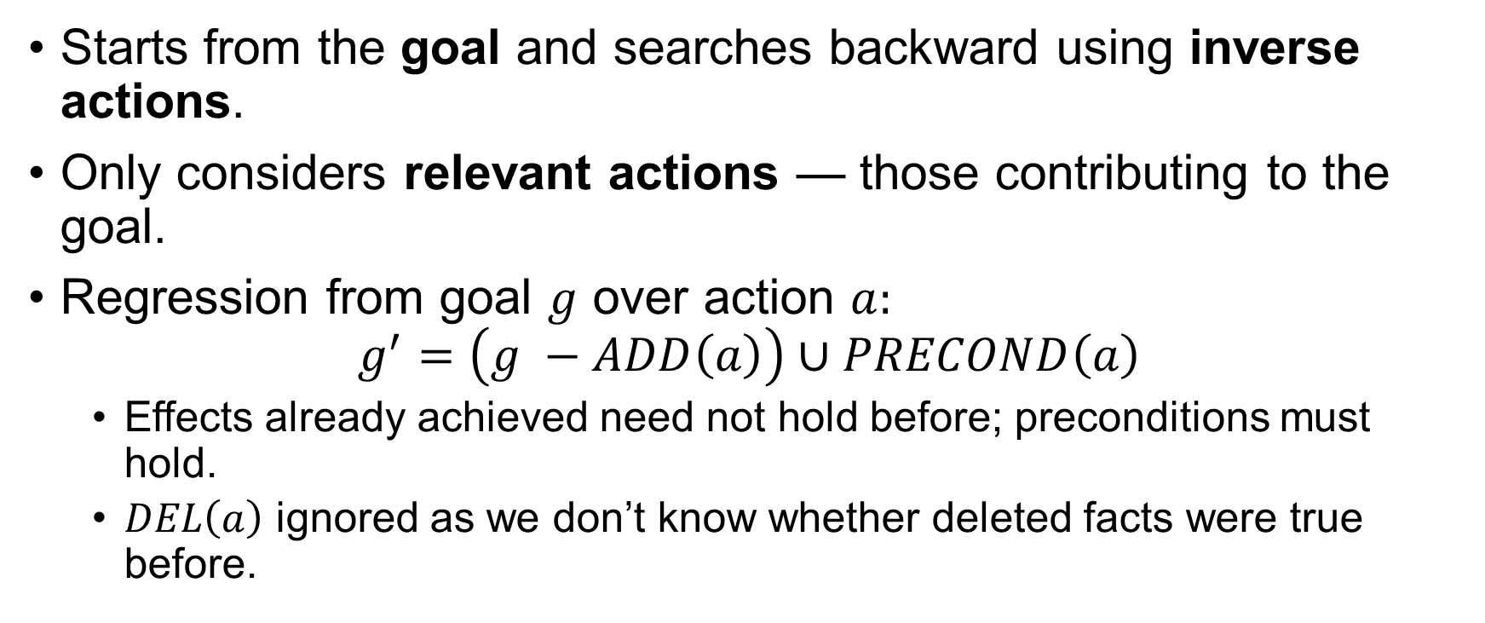
Backward (Regression) Search
Starts from the goal and searches backward using inverse actions.
Only considers relevant actions — those contributing to the goal.
Regression from goal $g$ over action $a:$ $g^{′}=\left(g −ADD\left(a\right)\right)∪PRECOND\left(a\right)$
Effects already achieved need not hold before; preconditions must hold.
$DEL\left(a\right)$ ignored as we don’t know whether deleted facts were true before.

Slide 18
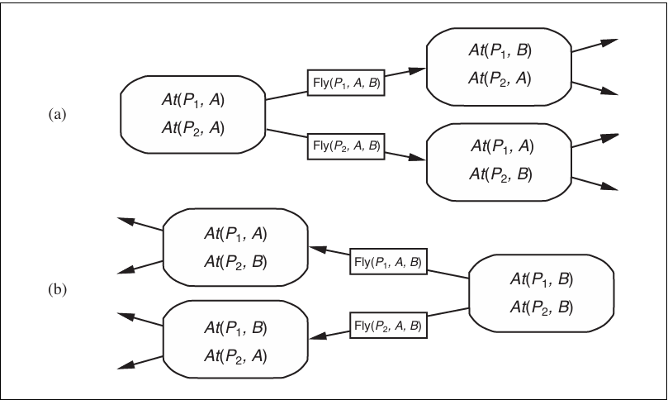
Forward vs Backward

Slide 19
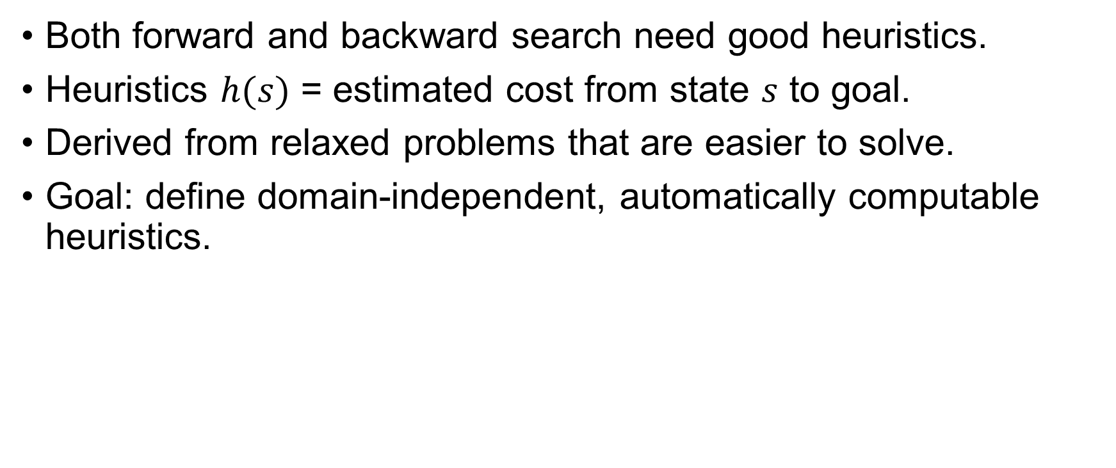
Heuristics for Planning
Both forward and backward search need good heuristics.
Heuristics $h(s)$ = estimated cost from state $s$ to goal.
Derived from relaxed problems that are easier to solve.
Goal: define domain-independent, automatically computable heuristics.

Slide 20
Relaxed Problem Heuristics
Relaxed = make the problem easier by:
Adding edges – ignore constraints.
Reducing nodes – state abstraction.
The cost of solving the relaxed problem = heuristic estimate.
Two classic relaxations:
Adding More Edge - Ignore preconditions
Grouping Multiple Nodes Together - Ignore delete lists.

Slide 21
Ignore Preconditions Heuristics
Drop all precondition from actions.
Any action can be applied anywhere.
Approximation: number of unsatisfied goal literals.
More accurate: use minimal set of actions whose effects cover the goal.
Equivalent to a set cover problem.

Slide 22
Ignore Delete Lists Heuristics
Remove all negative effects from actions.
Once a goal is achieved, it stays true.
Simplifies search space – no dead ends.
Still NP-hard, but approximable with hill-climbing.
Used in modern planners like FF.

Slide 23
State Abstraction
Instead of relaxing actions, simplify the state space.
Map multiple concrete states into one abstract state.
Example:
Abstract solution gives admissible heuristic and easier computation.

Slide 24
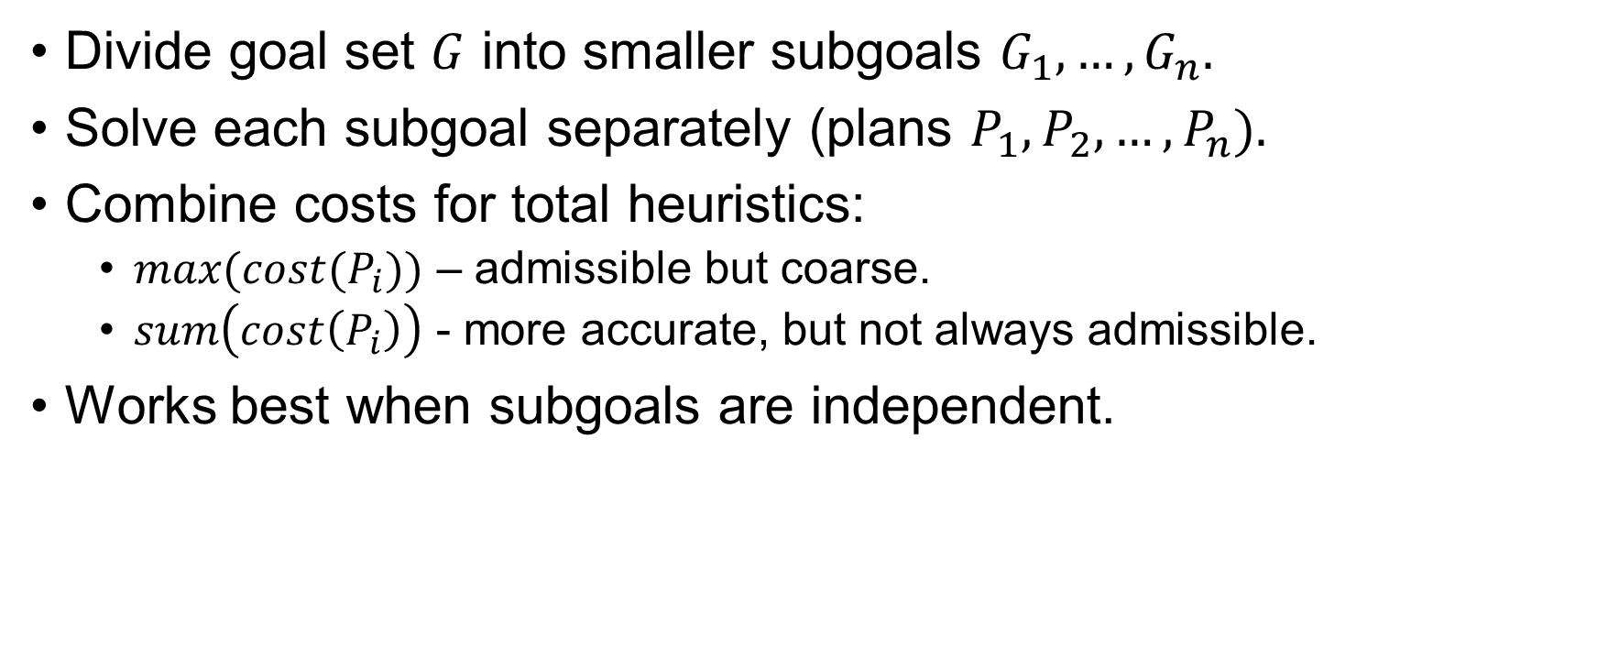
Decomposition and Subgoal Independence
Divide goal set $G$ into smaller subgoals $G_{1}, …, G_{n}.$
Solve each subgoal separately (plans $P_{1}, P_{2}, …, P_{n}).$
Combine costs for total heuristics:
$max(cost(P_{i}))$ – admissible but coarse.
$sum\left(cost\left(P_{i}\right)\right)$ - more accurate, but not always admissible.
Works best when subgoals are independent.

Slide 25
FF (FastForward) Planner
Modern planner using ignore-delete-lists heuristic.
Builds planning graph to estimate heuristic values.
Performs hill-climbing search toward better heuristic scores.
Uses iterative deepening to escape plateaus or local maxima.
Achieves fast, domain-independent planning.

Slide 26
Motivation for Planning Graphs
Traditional heuristics often give inaccurate estimates.
A planning graph provides a more informed, admissible heuristic.
Used in two ways:
To derive heuristics for search algorithms.
To directly extract plans using the GraphPlan algorithm

Slide 27
Planning Graph
A compact, polynomial-sized structure approximating the full search tree.
Alternates between state levels (Si) and action levels (Ai).
Each level represents what could be true or possible at a given time.
Cannot guarantee reachability but never overestimates plan length → admissible heuristic.

Slide 28
Structure of a Planning Graph
Starts with S₀: literals true in the initial state.
Then A₀: all actions whose preconditions are met in S₀.
Followed by S₁, A₁, and so on — until the graph levels off (no new info).
Each Si contains possible literals, even conflicting ones (e.g., P and ¬P).
Includes persistence actions (“no-ops”) to maintain fluents over time.

Slide 29
Mutual Exclusion (Mutex)
Records conflicts between actions or literals.
Two actions are mutex if they have:
Inconsistent effects: one negates another’s effect.
Interference: one negates another’s precondition.
Competing needs: their preconditions are mutex.
Two literals are mutex if:
One negates the other, or
Their supporting actions are mutex (inconsistent support).

Slide 30
The “Have Cake and Eat Cake” Problem
Actions:
Eat(Cake): consumes the cake, produces Eaten(Cake).
Bake(Cake): restores Have(Cake).
Planning graph builds levels of possible states and actions, recording mutexes (e.g., can’t Eat and Have simultaneously).
Demonstrates how planning graphs approximate reachability and help compute heuristic costs.

Slide 31
Heuristic Estimation with Planning Graphs
Level cost of literal g: first level Si where g appears.
Common heuristics:
Max-level: max of level costs of goals (admissible, coarse).
Level-sum: sum of level costs (not always admissible but effective).
Set-level: first level where all goals appear without mutexes (admissible, accurate).
The graph acts as a relaxed problem, ignoring higher-order conflicts.

Slide 32
The GraphPlan Algorithm
Builds the planning graph incrementally until goals are non-mutex.
Then performs backward search to extract a valid plan.
If fails → expands one more level and retries.
Guarantees termination: when both the graph and “no-good” table level off, no plan exists.

Slide 33
Inside GraphPlan
Expansion phase: add new Ai, Si, and recompute mutexes.
Solution extraction: backward CSP-style search for a set of non-mutex actions that achieve the goals.
Uses no-good learning to avoid repeated dead ends.
Often guided by level-cost heuristics (prefer easier subgoals first).

Slide 34
Termination and Properties
Monotonicity ensures termination:
Literals and actions increase monotonically.
Mutexes and no-goods decrease monotonically.
When two consecutive levels are identical → graph has leveled off.
If no plan by then → problem is unsolvable.

Slide 35
Impact and Competitions
Planning graphs revolutionized heuristic planning.
GraphPlan inspired many top planners:
IPP, LPG (graph-based)
FF, LAMA (heuristic search)
SATPLAN (SAT-based)
Shaped modern satisficing and optimal planning systems.

